Slide 1
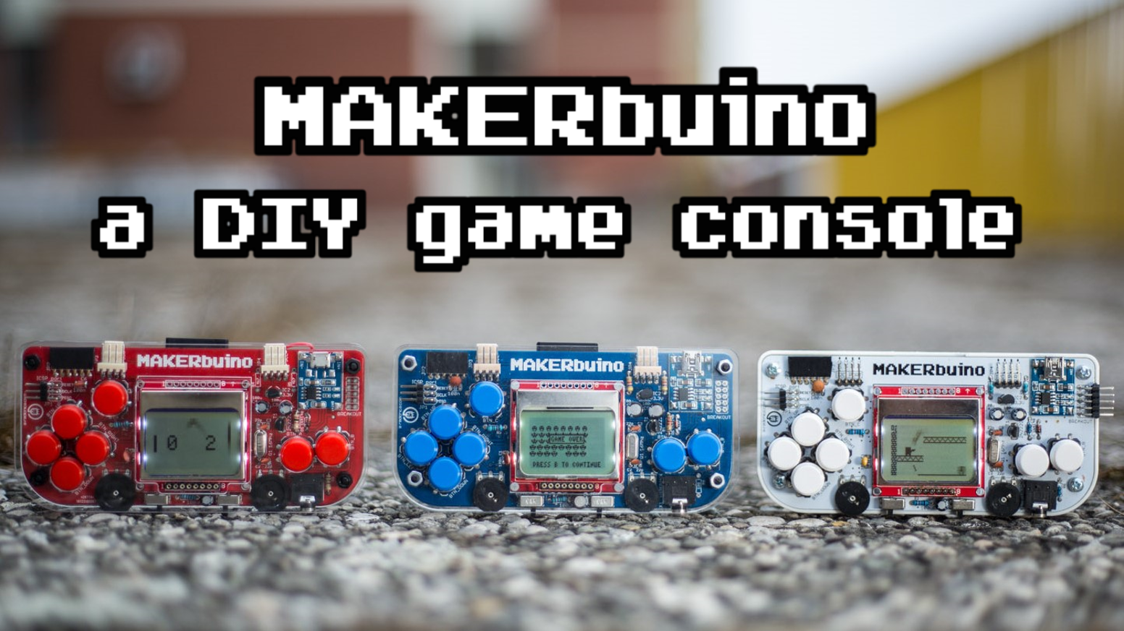
1

Slide 2
Table of contents
2
General presentation
Different kits
Components
Button, sound and storage
Adapters and connectivity
Resistor, capacitors, quartz and micro controler
Other components
Step of the build
Community
Other products
My opinion

Slide 3
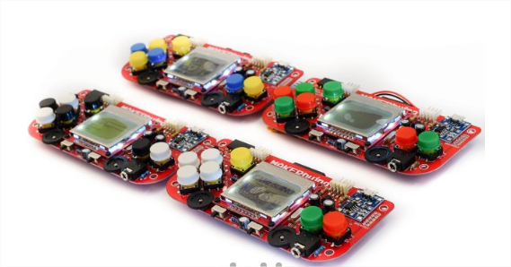
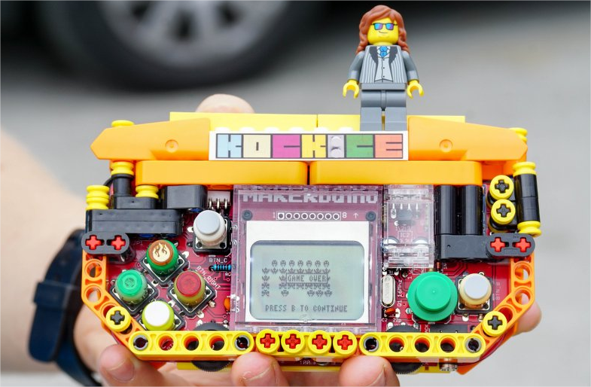
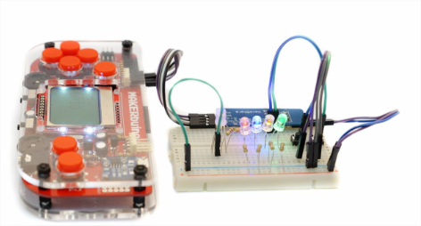
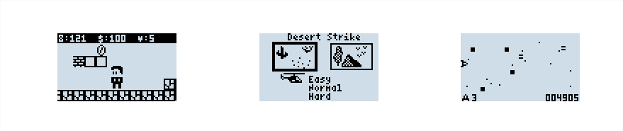
General presentation
3
Open source gameboy DIY (Do It Yourself)
Many video games
Build time : 5 – 6 h with soldering iron
Remote control
Customization
20 yo italian
8bit retro games

Slide 4
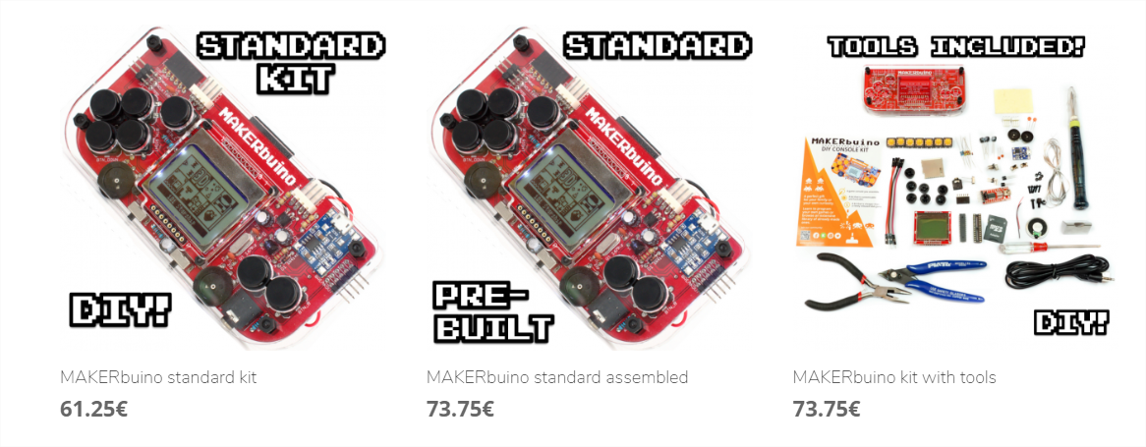
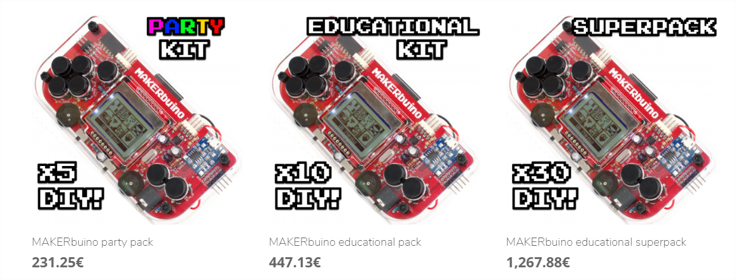
Different kits
4

Slide 5
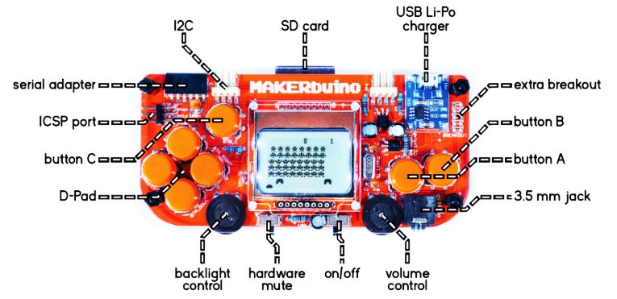
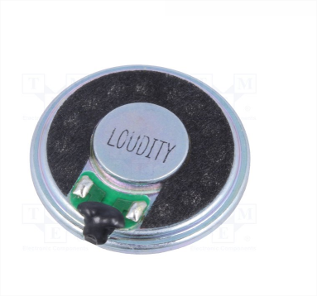
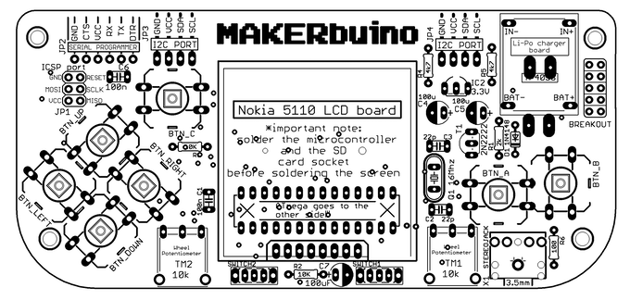
Buttons, sounds and storage
5
Potentiomete
A B C up down right left
On/off
Mute
Jack
SD socket
SD card 128Mo

Slide 6
Adapters and connectivity
6
Usb adapter
ICSP port
Extra breakout
Serial adapter
Screen: nokia 5110 LCD

Slide 7
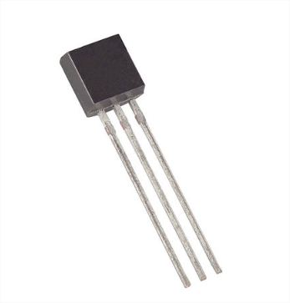
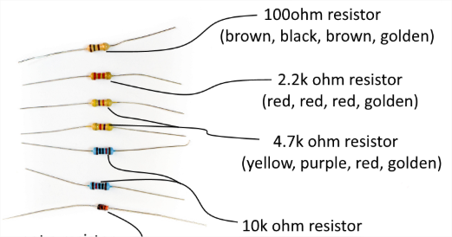
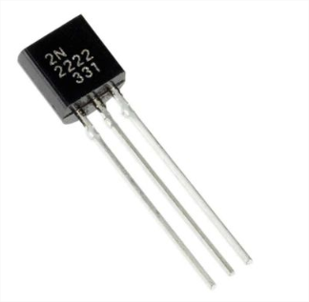
Resistor, capacitors, quartz and micro controler
7
Voltage Regulator 3.3 V
2n2222 NPN Transistor
Amplifier of sound

Slide 8
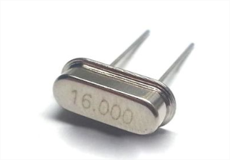
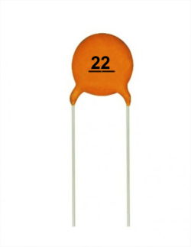
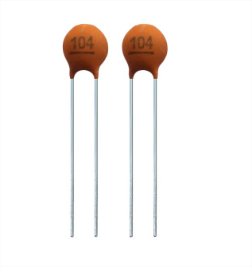
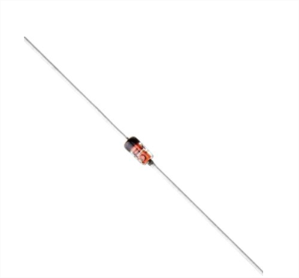
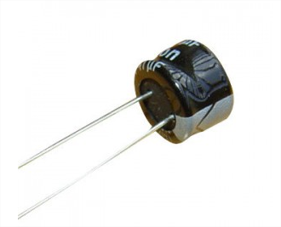
8
22pF ceramic capacitors (for 16MHz oscillating circuit)
16MHz Crystal for microcomputer oscillator
100nF ceramic capacitors (for filtration and for digital reset through the serial adapter board)
100µF Electrolytic Capacitors (filtrating noise and ensuring stable electrical current)
1N4148 Diode (for sound circuit)

Slide 9
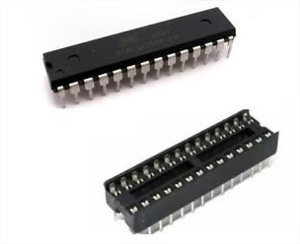
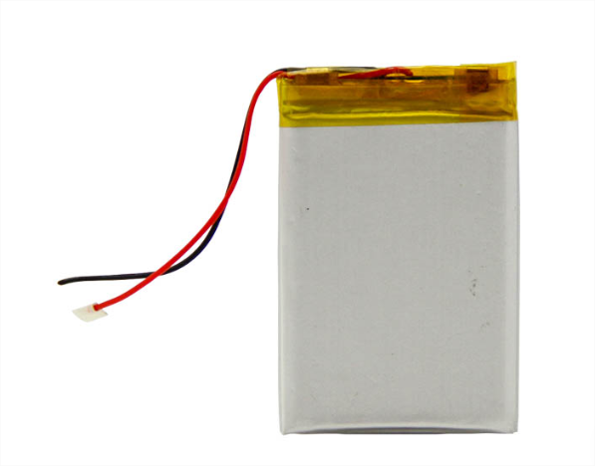
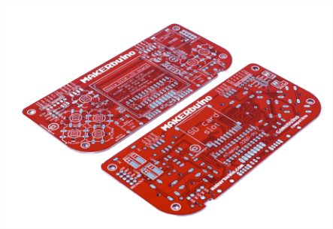
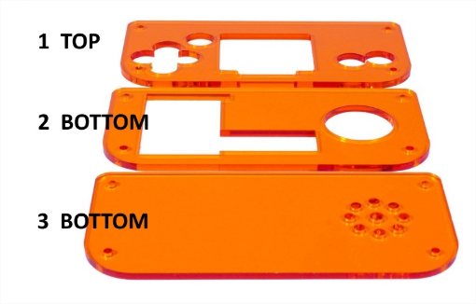
Other components
9
Microcontroller ATmega328p
CPU (8bit) ,RAM(2kB)
Li-Po battery (Lithium Polymer) 3.7V
PCB circuit board (weld it on both side)
Laser cut acrylic casing

Slide 10
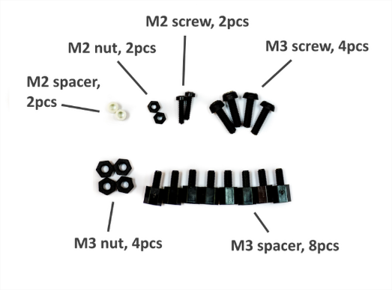
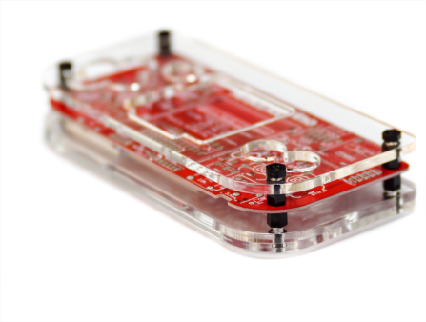
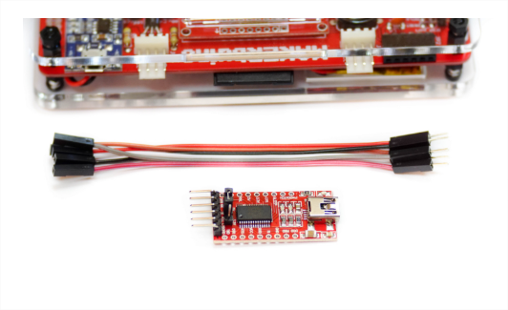
10

Slide 11
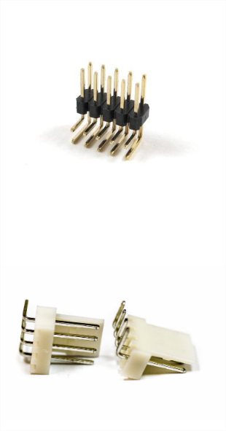
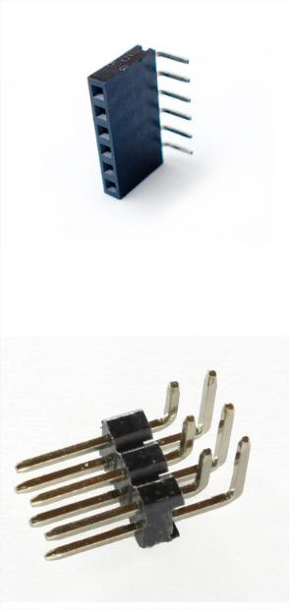
11
2x5 male angle extra breakout header
Extra option for hardware expansions
6 pin angled female header
For connecting MARKERbuino with PC
KF2510 4-pin anti-reverse angle headers for i2c ports
For multiplayer option
2x3 male angled ICSP header
For connecting expansion modules and an ISP programmer for reprogramming the game console’s microcontrolleur

Slide 12
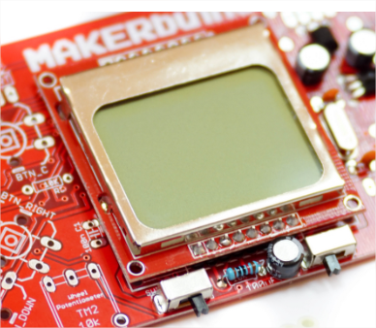
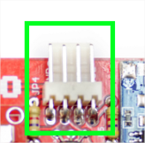
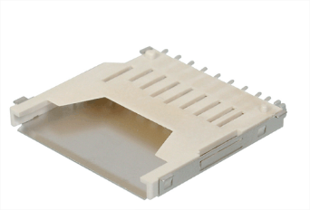
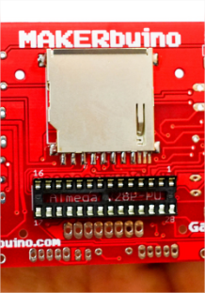
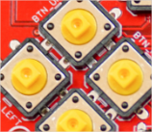
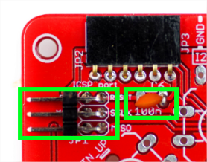
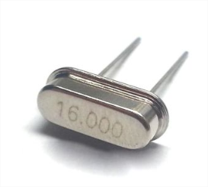
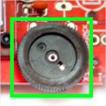
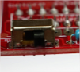
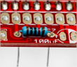
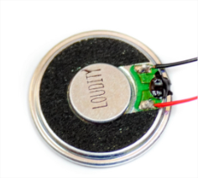
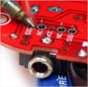
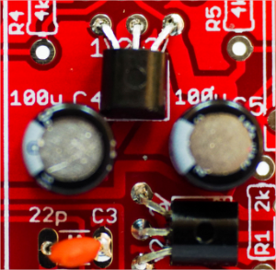
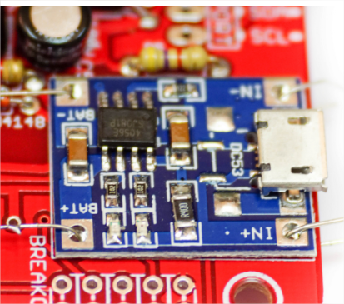
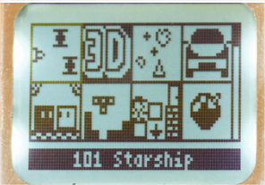
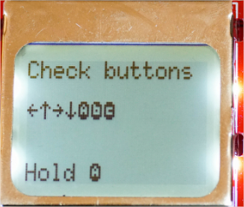
Step of the built
12
5 – screen
9 – multiplayer headers
1 – SD socket
6– headers, others resistor / capacitors and potentiometers
2 – Microcomputer socket’s
10– pushbuttons
3 – some resistor, quartz, buttons
11– speaker
7 –headphone connector
4 – transistors and capacitors
12– set up and have fun !
8 –charger
board

Slide 13

Community
13

Slide 14
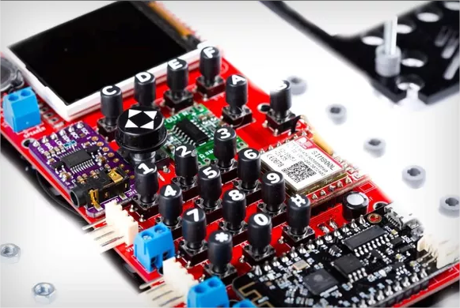
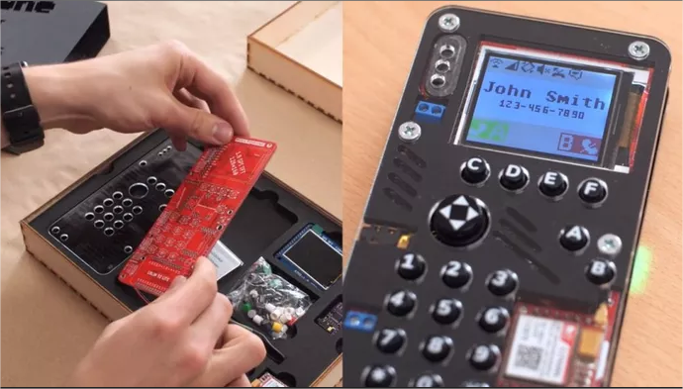
Other products
14

Slide 15

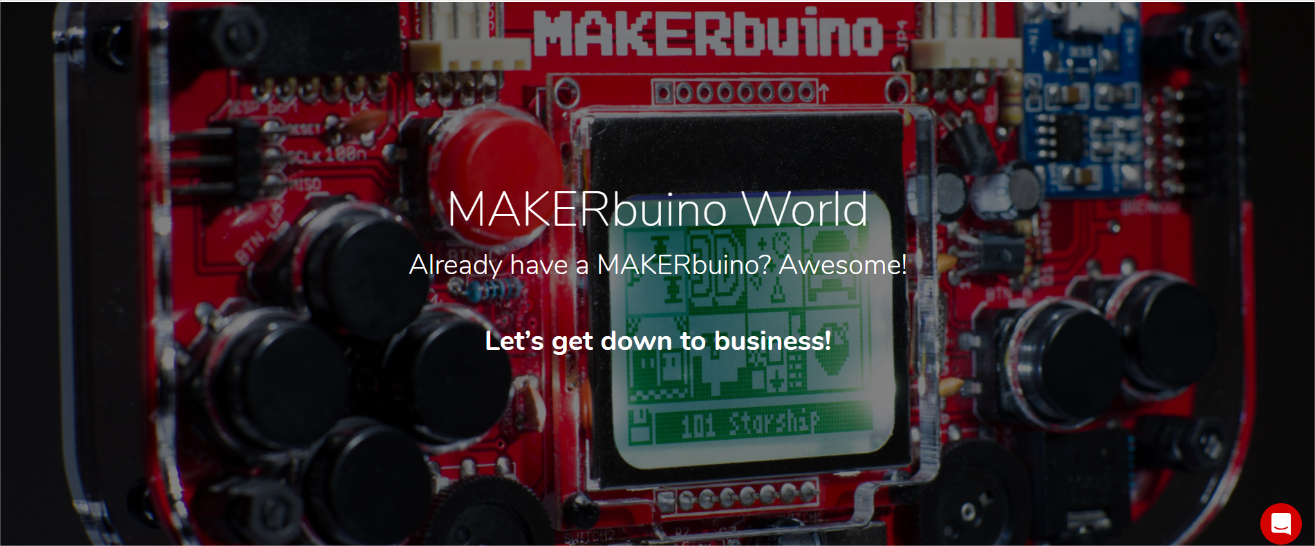
My opinion
15

